Slide 1

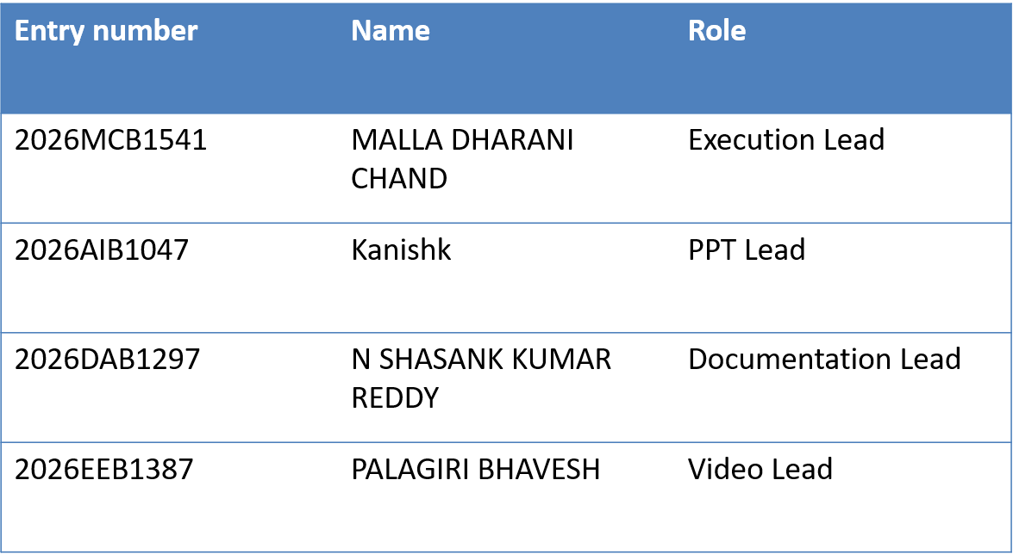
VGC META-GATEKEEPER
Predicting the
competitive meta
THE QUESTION
Which Pokémon
cross the meta
gate?
Can Pokémon attributes identify the species most likely to shape the VGC World Championships?
Team number : 30
A leakage-safe, interpretable baseline for rare competitive picks.
Git Hub repo link:
https://github.com/2026dab1297-dotcom/vgc-meta-predictor.git

Slide 2


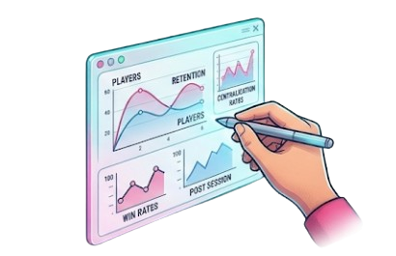
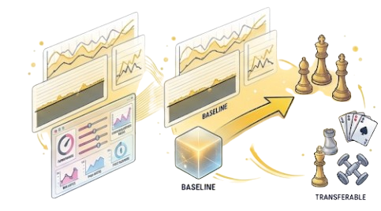
VGC META-GATEKEEPER
Define the competitive gate
Official VGC doubles
RESEARCH QUESTION
Players bring a team and select four; two Pokémon battle at a time.
Can static attributes predict Worlds meta usage?
Target: META = 1 when Worlds usage is at least 1%.
1,000+ species
Only a small adapted core appears consistently at the highest level.
Rare-positive warning
Accuracy can hide a model that predicts “not meta” for everyone. Recall and F1 matter more.
Dataset Information :
WHY IT MATTERS
Dataset Source:
https://www.kaggle.com/datasets/danielsmdev/pokemon-competitive-usage-smogon-and-vcgworlds
Prepare faster
Balance smarter
Build a baseline
Focus practice on likely tournament threats.
Track fairness and competitive diversity.
Reuse the method in future formats and games.
Dataset Size:
Original : 1303 rows x 23 columns
After removing Mega and Gigantamax forms: 1221 x 23
02

Slide 3
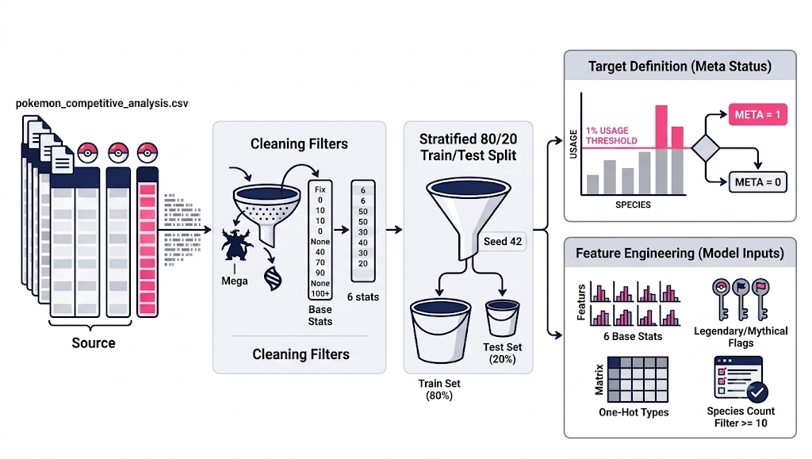
VGC META-GATEKEEPER
Build a leakage-safe baseline
LOGISTIC REGRESSION
Features × weights → sigmoid → P(meta)
Positive coefficients raise predicted probability; negative coefficients lower it. Fast, interpretable baseline.
PIPELINE
1 Scale features
2 Select top 25 + six base stats
3 Weight rare-class errors
4 Tune C with 5-fold F1 cross-validation
Libraries used:
pandas
NumPy
scikit-learn: StandardScaler, SelectKBest ,Logistic Regression, cross-validation
Matplotlib
Seaborn for analysis plots
EDA / coefficient signal: offense and tempo may matter; Special Attack raises probability, while legendary status lowers it in this dataset. Association is not causation.
03

Slide 4


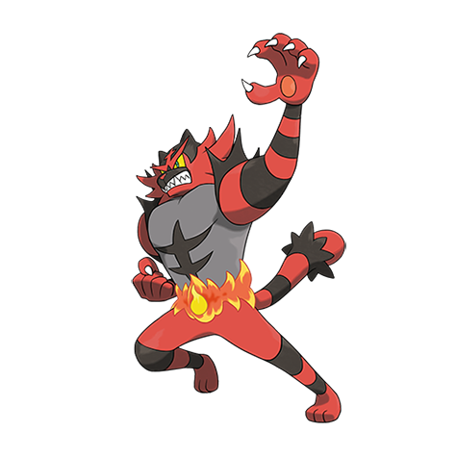
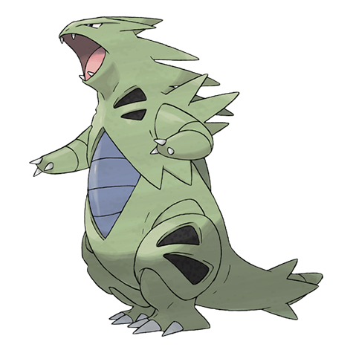
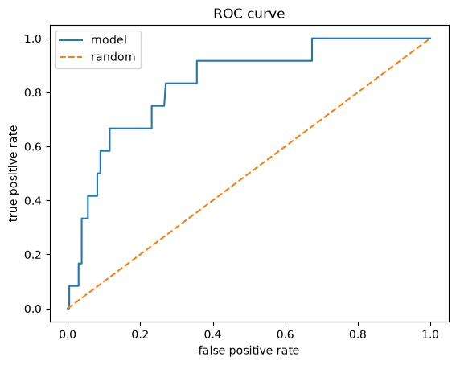
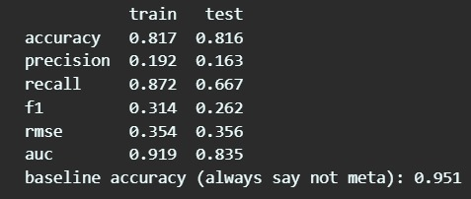
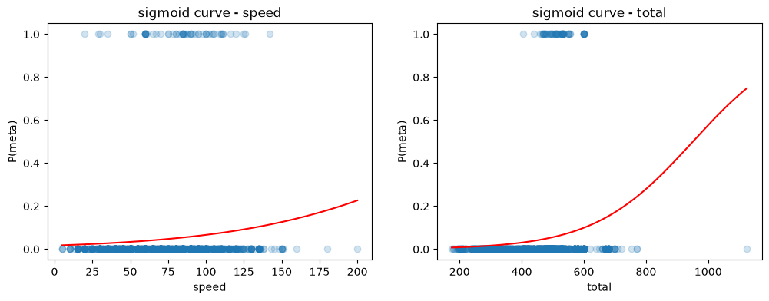
VGC META-GATEKEEPER
What the model catches—and misses
TEST SET CONFUSION MATRIX
CASE STUDIES
HITS
Actual class
Predicted not meta
Predicted meta
Incineroar — Intimidate is a visible, model-friendly signal.
Tyranitar — high base stats crossed the learned gate.
Not meta
192
41
Meta
4
8
MISSES
Rillaboom — 29.72% usage; predicted P(meta) ≈ 0.27.
Corviknight — 2.43% usage; role context was missed.
From these counts: accuracy 81.6% · precision 16.3% · recall 66.7% · F1 26.2%
Minority-class errors remain important: 4 missed metas and 41 false alarms.
The model sees attributes, but not moves, team roles, or matchup context.
04

Slide 5
VGC META-GATEKEEPER
Turn the baseline into better preparation
WHAT IT CAN SUPPORT
What didn’t work:
Precision of only 16.3%, with 41 false alarms. Stats alone can’t capture moves or team roles.
Use likely threats to focus team-building, matchup drills, and practice time. Track whether competitive variety is expanding or shrinking.
Moves and item data
Team-role signals such as Fake Out, Grassy Glide, and Tailwind
Multiple Worlds seasons
Random Forest and boosting comparisons
WHAT TO ADD NEXT
What Worked :
Recall of 66.7% and AUC of 0.835 show the model catches most meta Pokémon from stats alone.
Malla Dharani Chand - Execution Lead
Kanishk - PPT Lead
N Shasank Kumar Reddy - Documentation Lead
Palagiri Bhavesh - Video Lead
WHO DID WHAT
MODEL LIMITS
Cross-validation chose C = 10 (5-fold F1 ≈ 0.25), meaning weak regularization worked best. Predictions used the default 0.5 cutoff, which may not be the best choice. The threshold should reflect the cost of missed metas versus false alarms.
A repeatable baseline is a starting point. Better context and more seasons can help the model learn rare competitive picks.
AI – USE DISCLOSURE:
AI TOOLS USED :
CLAUDE – FOR UNDERSTANDING THE CODE AS SOME OF THE LIBRARIES HAD TO BE UNDERSTOOD AND CHECKING UP WITH THE DATA ANALYSIS
CHAT GPT : USED WITH CLAUDE FOR RECHECKING OF DATA AND CODE
GEMINI : FOR TEXT TO IMAGE GENERATION
05

